Slide 1
GDAI
Playing Geometry Dash with Deep Q Reinforcement Learning

Slide 2
01
02
Challenges
03
04
Reading in the screen
Detecting death
The model needed something to interpret and other than reading in the memory, reading in the display is the only way.
Without an environment, I had to find a way to detect when the AI dies to know when to move on to the next episode.
Input (Jumping)
Reward Metric
There is only one input in GD which is pressing the mouse button to jump. You can also hold to continuously jump.
The main goal of the game is to go as far as possible in one level.

Slide 3
Reading in the Screen
PIL: ImageGrab
mss
ImageGrab is the first display reading library I tried. It worked after a little tuning, but when I tried to run the AI with it, I realized it took a long time to read in the display. This resulted in an fps of about 3 because GD runs at the same speed.
To solve the low fps problem, I looked for a faster display grabbing library. One user on stack overflow claimed he could get a stable 60 fps with mss. In my experience, it is more around ~15 fps but it was definitely an upgrade from 3

Slide 4
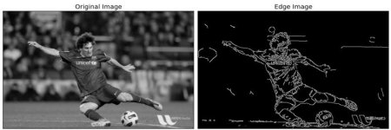
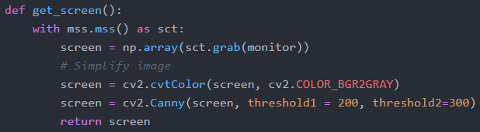
To make the image easier to read in for the CNN, I cropped it to only include useful information, changed it to grayscale, and did edge detection.
(I’m still not sure if edge detection actually helps)

Slide 5
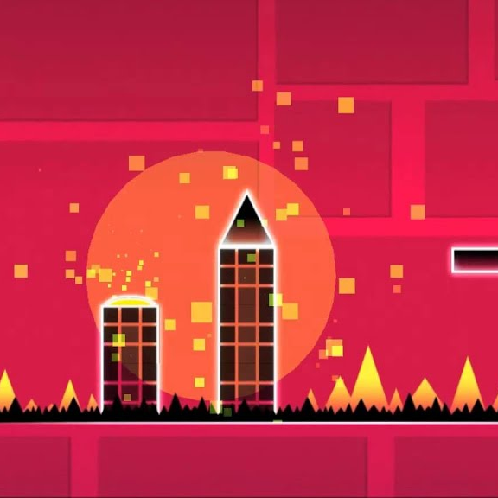
Detecting Death
Dead
I detected images by continuously comparing the previous frame to the current frame and seeing if their similarity was < 99.9% using compare_ssim from sklearn.image. If the similarity was below 99.9% the the bot is still alive. I also used a frame queue to make sure it was checking older frames.

Slide 6
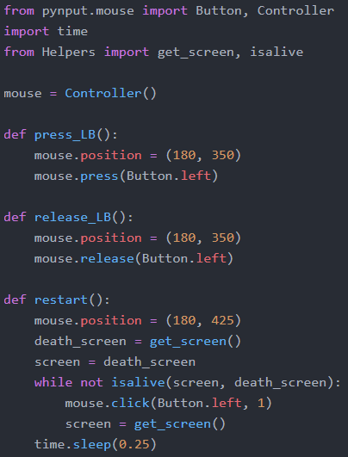
Input (Jumping)
Used the pynput library to click with a mouse

Slide 7
Reward Metric
There were three possible reward metrics I tried
Number of rounds
Penalize whenever you jump
Penalize whenever you change input
I wanted to penalize jumping to make the bot learn to play like an actual player that only jumps when necessary. For changing inputs, geometry dash has a low click challenge for every level. (I ended up just using the time alive)

Slide 8
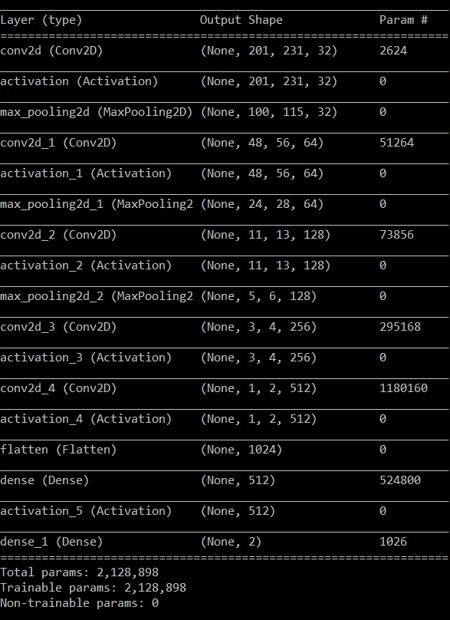
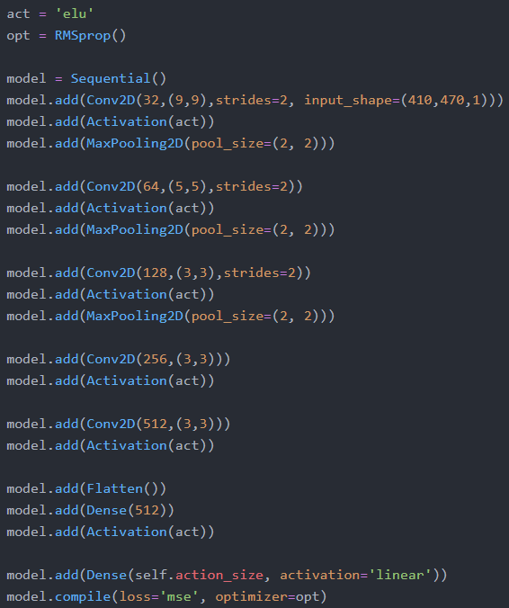
CNN
(With mostly arbitrary parameters)

Slide 9
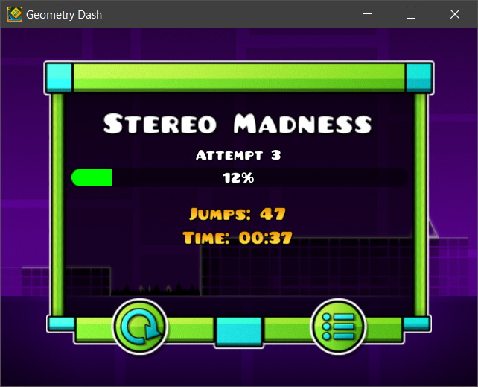
Results
My original goal was to reach the first ship part in Stereo Madness. My best score was 12% through which was about a third of the way to the ship part.

Slide 10
Possible Future Features to Implement
Object Recognition
Better Jumping
Randomized Levels
Instead of giving the neural network the display I could give it the sizes and position of objects relative to itself.
Only possible with object recognition, but I could make sure the neural network does not make any decisions that are not used (when player is in the air)
To prevent overfitting on just Stereo Madness

